Slide 1


Experiential Reinforcement Learning
Taiwei Shi
University of Southern California
taiweis.com
taiweish@usc.edu

Slide 2



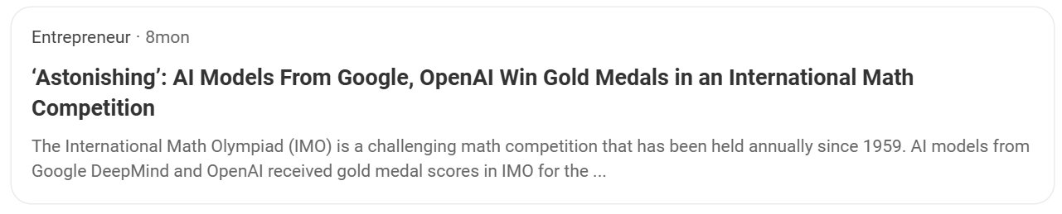
What are these systems?

Slide 3



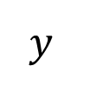
Language Models (LMs)
$$P(y | x)$$
$$x$$
Policy
$$y$$
The capital city of New York is
Albany
Supervision comes from human data

Slide 4


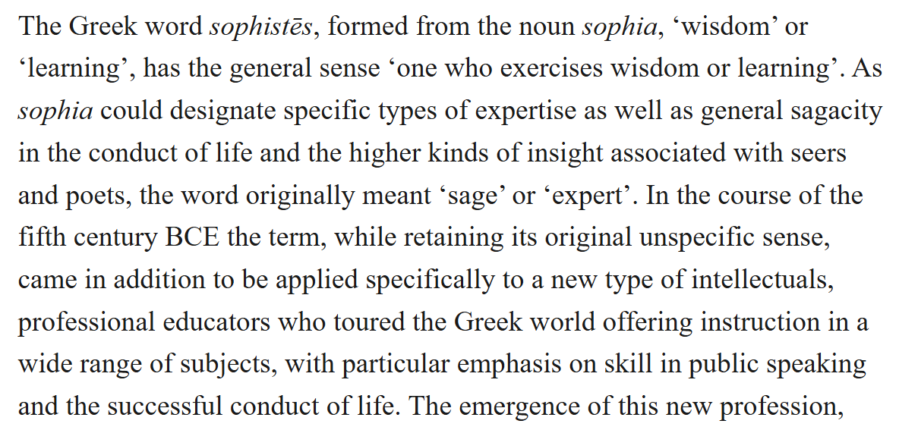



LM Pipeline: Data

Slide 5
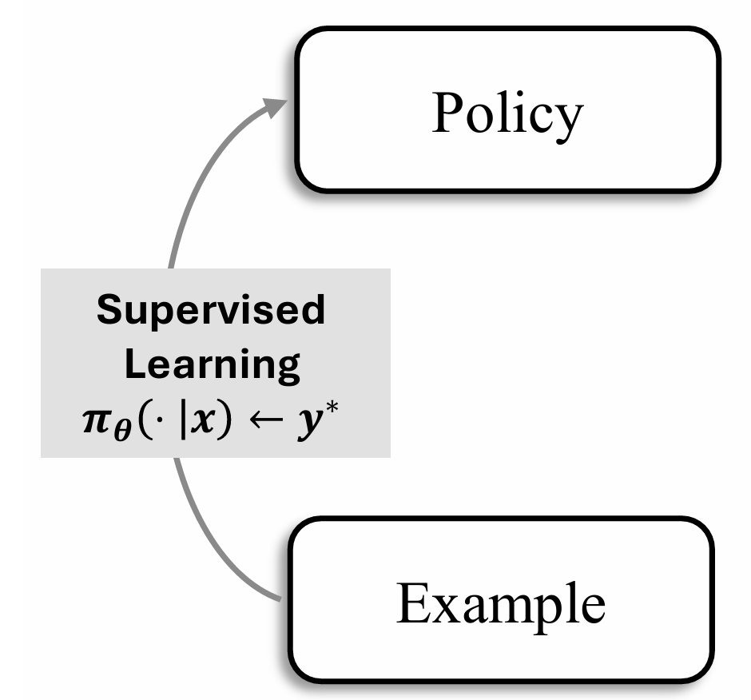
LM Pipeline: Supervised Learning (SFT)
The capital city of New York is
Albany
Ithaca
Buffalo
…

Slide 6

Supervised Learning (SFT): Problems
High-quality human data is being exhausted

Slide 7
Supervised Learning (SFT): Problems
High-quality human data is being exhausted
Gains from supervised learning are slowing

Slide 8
Supervised Learning (SFT): Problems
High-quality human data is being exhausted
Gains from supervised learning are slowing
Bounded by human performance

Slide 9
Can we enable LLMs to move beyond imitating human data to learning from their own experience?

Slide 10
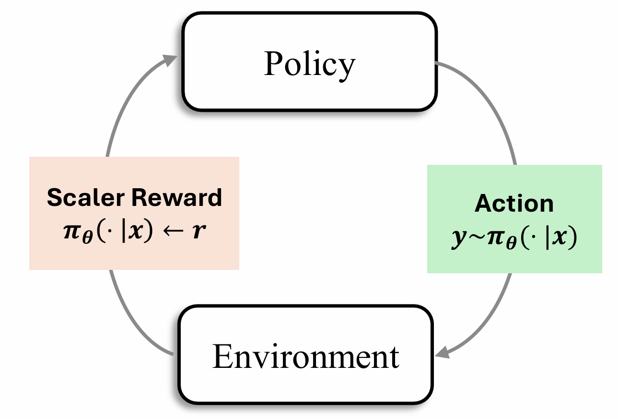
LM Pipeline: Reinforcement Learning
Learning from experience is
NOT fully realized in LMs yet
Notes:
This idea is not new. Reinforcement learning was developed as an attempt to enable agents to learn from experience.
In reinforcement learning, an agent interacts with an environment, takes actions, observes the outcomes, and improves based on feedback. In this sense, reinforcement learning provides a framework for learning from experience.
However, in current language models, this idea is not yet fully realized. In this talk, I will show the current limitations of how reinforcement learning is used in LLMs, and how we can address them.

Slide 11
RL relies on repeated trial-and-error
A: After Tom giving 5 candles away, he has 8 left. Then adding 3…
Answer: 11
Q: Tom has 12 candies. He gives 5 to his friend and then buys 3 more. How many candies does Tom have now?
A: Tom starts with 12 candies. After giving 5 away, he has 7 left…
Answer: 10
A: Tom has 12 candies. Adding 5 candles gives him 18. Then…
Answer: 14

Slide 12
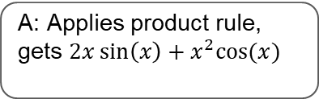

Most experiences are uninformative
Q: What is 2+2?
A: 2 + 2 = 4
Far beyond ability -> no learning
Q: Prove the Riemann Hypothesis
A: Tom has 12 candies. Adding 5 candles gives him 18. Then…
Already knows this -> no learning
Q: Find the derivative of $x^{2}\sin\left(x\right)$
A: Applies product rule, gets $2x\sin\left(x\right)+x^{2}cos⁡(x)$
Challenging but solvable -> useful learning

Slide 13
LLM RL
Problem
Step 1: …
Step 2: …
…
Step n: …
Answer: …
Reward = 0

Slide 14

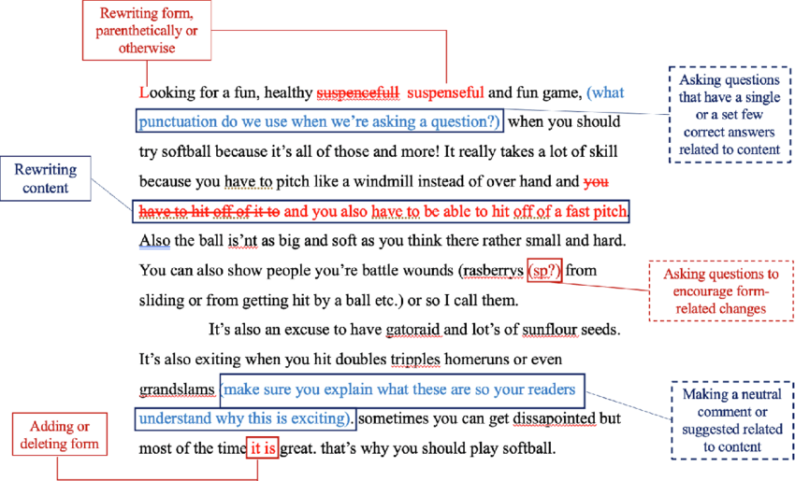
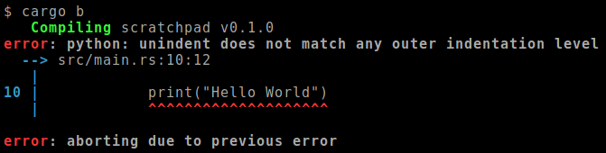
LLM RL
Problem
Step 1: …
Step 2: …
…
Step n: …
Answer: …
Reward = 0
Feedback is compressed into a scalar signal!

Slide 15
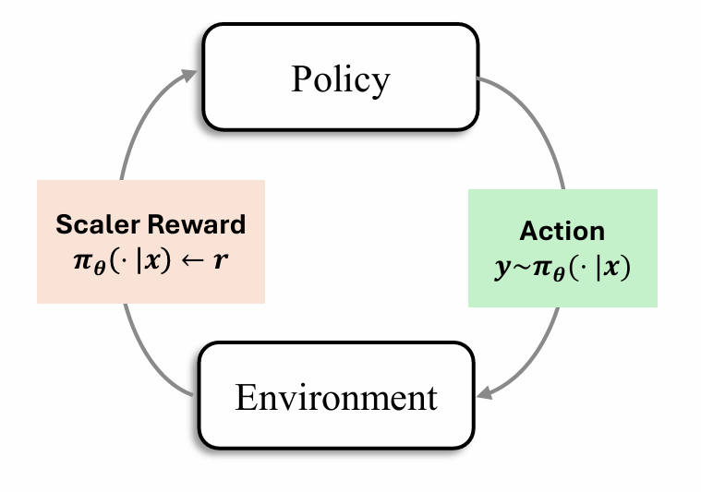
Experience is poorly utilzied in standard RL
Feedback is reduced to a scaler value
No explicit interpretation of experiences
No clear direction for behavioral revision

Slide 16
How can models effectively use past experiences, rather than relying solely on scalar rewards?
Shi et al. Experiential Reinforcement Learning

Slide 17
How to improve?
What if LMs don’t just learn from scaler rewards directly, but learn by “reflecting” on it?
Experience: interacts with the environment and collects feedback
Reflection: interprets feedback to identify mistakes and infer how to improve
Consolidation: internalize these insights to guide future behavior
Experience
Consolidation
Reflection

Slide 18
Experience – Reflection – Consolidation
Problem
Step 1: …
Step 2: …
…
Step n: …
Answer: …
Reward = 0

Slide 19
Experience – Reflection – Consolidation
Problem
Why was I wrong? Which step did I start to go wrong?
Step 1: …
Step 2: …
…
Step n: …
Answer: …
Reward = 0

Slide 20
Experience – Reflection – Consolidation
Problem
I should stay away from Creeper next time…
Step 1: …
Step 2: …
…
Step n: …
Answer: …
Reward = 0

Slide 21
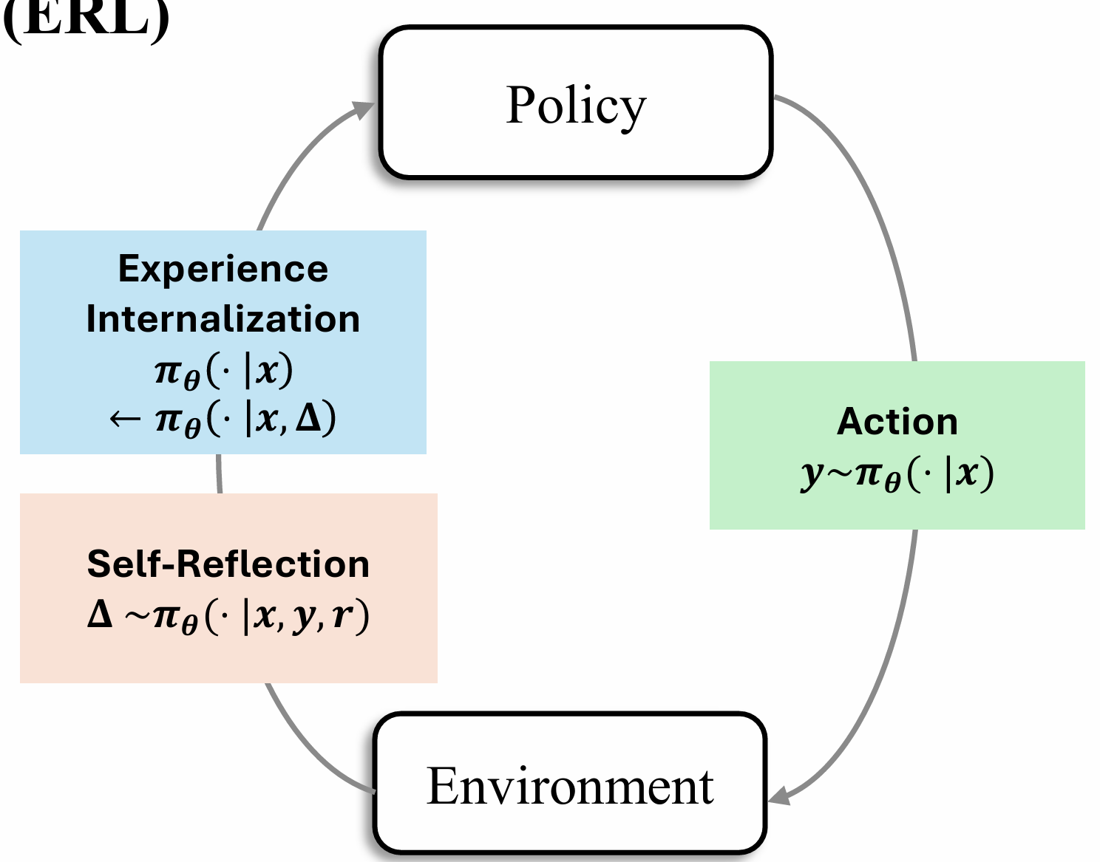
Experiential Reinforcement Learning
In each training step, an agent learns to:
Verbally reflect on observed outcomes
Internalize the reflections into its parameters, such that its behavior changes accordingly in the next iterations

Slide 22
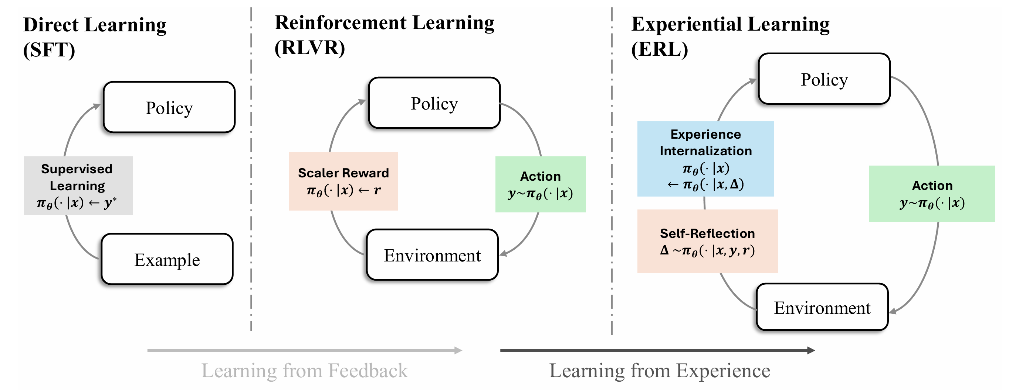

Slide 23
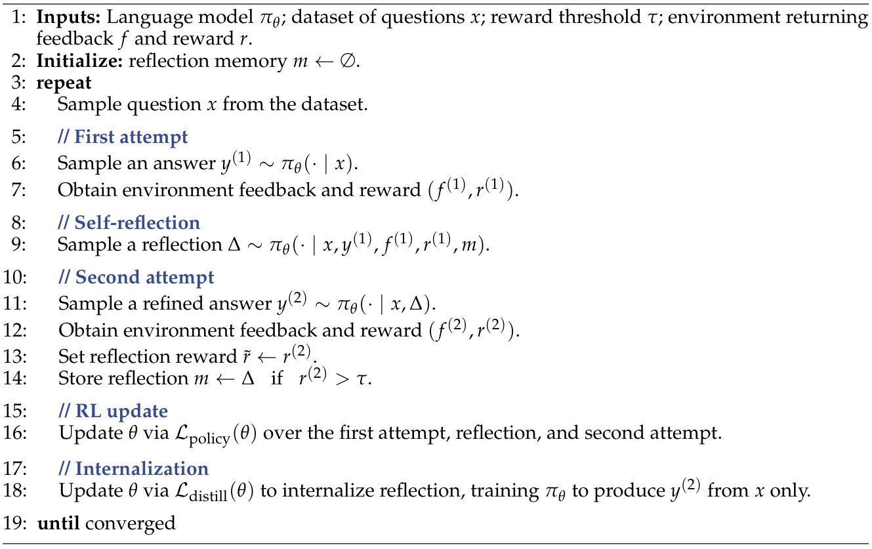
How ERL works?
In each training step:
LLM makes first attempt and receives feedback.

Slide 24
How ERL works?
In each training step:
LLM makes first attempt and receives feedback.
If success, learn from the attempt (via standard RL)

Slide 25
How ERL works?
In each training step:
LLM makes first attempt and receives feedback.
If success, learn from the attempt (via standard RL)
If failure,
Generate a reflection based on the feedback

Slide 26
How ERL works?
In each training step:
LLM makes first attempt and receives feedback.
If success, learn from the attempt (via standard RL)
If failure,
Generate a reflection based on the feedback
Based on the reflection, make a second attempt
Receives feedback again

Slide 27
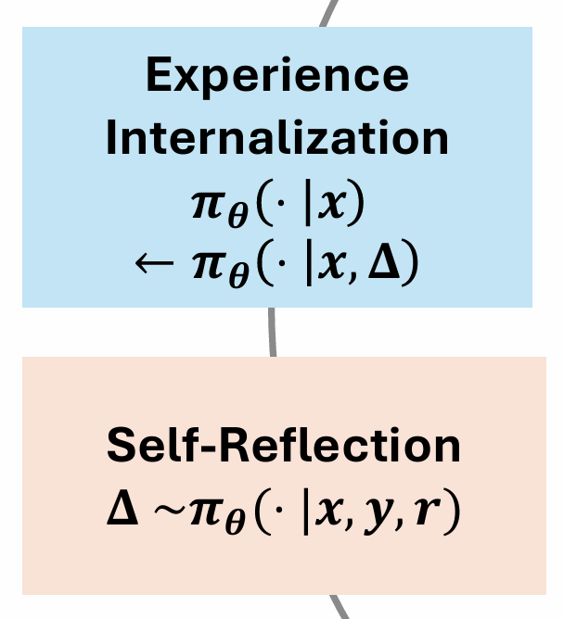
How ERL works?
In each training step:
LLM makes first attempt and receives feedback.
If success, learn from the attempt (via standard RL)
If failure,
Generate a reflection based on the feedback
Based on the reflection, make a second attempt
Receives feedback again
If the second attempt succeeded:
The hope is that LM can solve the task without seeing the “reflection”
We train the model to produce the same answer in 2nd attempt, with the original query only (no reflection)
This can be done via SFT, or on-policy distillation

Slide 28
How ERL works?
In each training step:
LLM makes first attempt and receives feedback.
If success, learn from the attempt (via standard RL)
If failure,
Generate a reflection based on the feedback
Based on the reflection, make a second attempt
Receives feedback again
If the second attempt succeeded:
The hope is that LM can solve the task without seeing the “reflection”
We train the model to produce the same answer in 2nd attempt, with the original query only (no reflection)
This can be done via SFT, or on-policy distillation

Slide 29

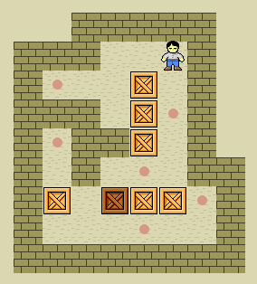
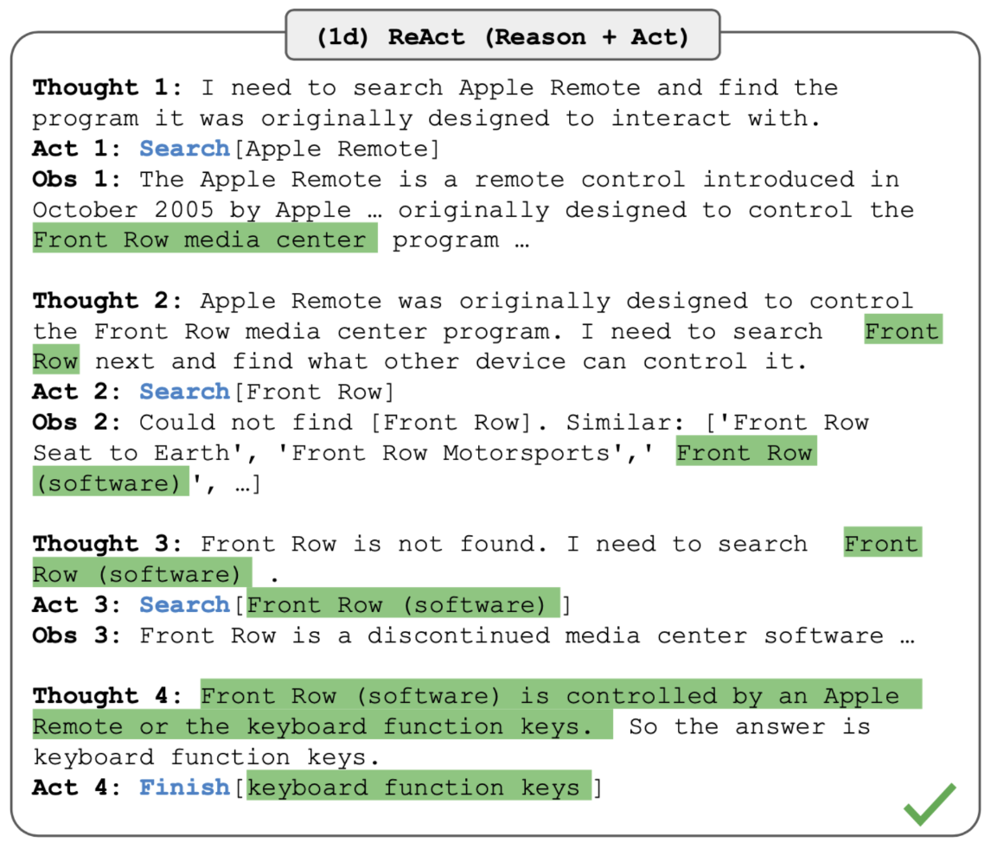
Evaluation Task
Frozen Lake
Learn to identify obstacles
Sokoban
Learn to solve puzzle
HotpotQA
Learn to use agentic tools
No prior knowledge is provided
The model has to learn purely from experience
Notes:
We don’t provide the goal, rules, etc. in the system prompts.

Slide 30
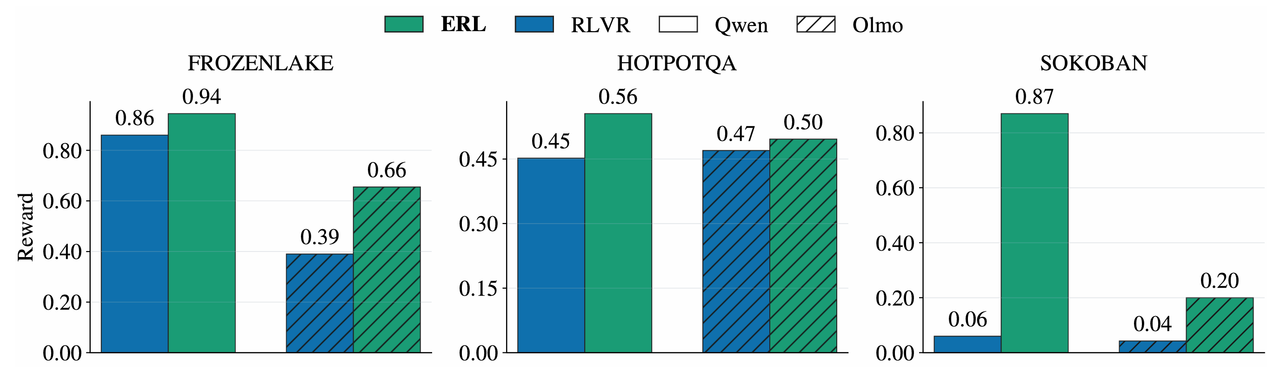
Evaluation: End Performance

Slide 31
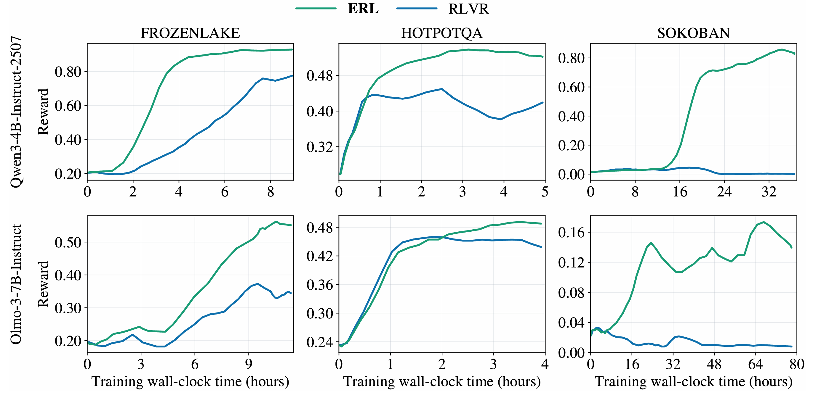
Evaluation: Wall-Clock Training Efficiency

Slide 32
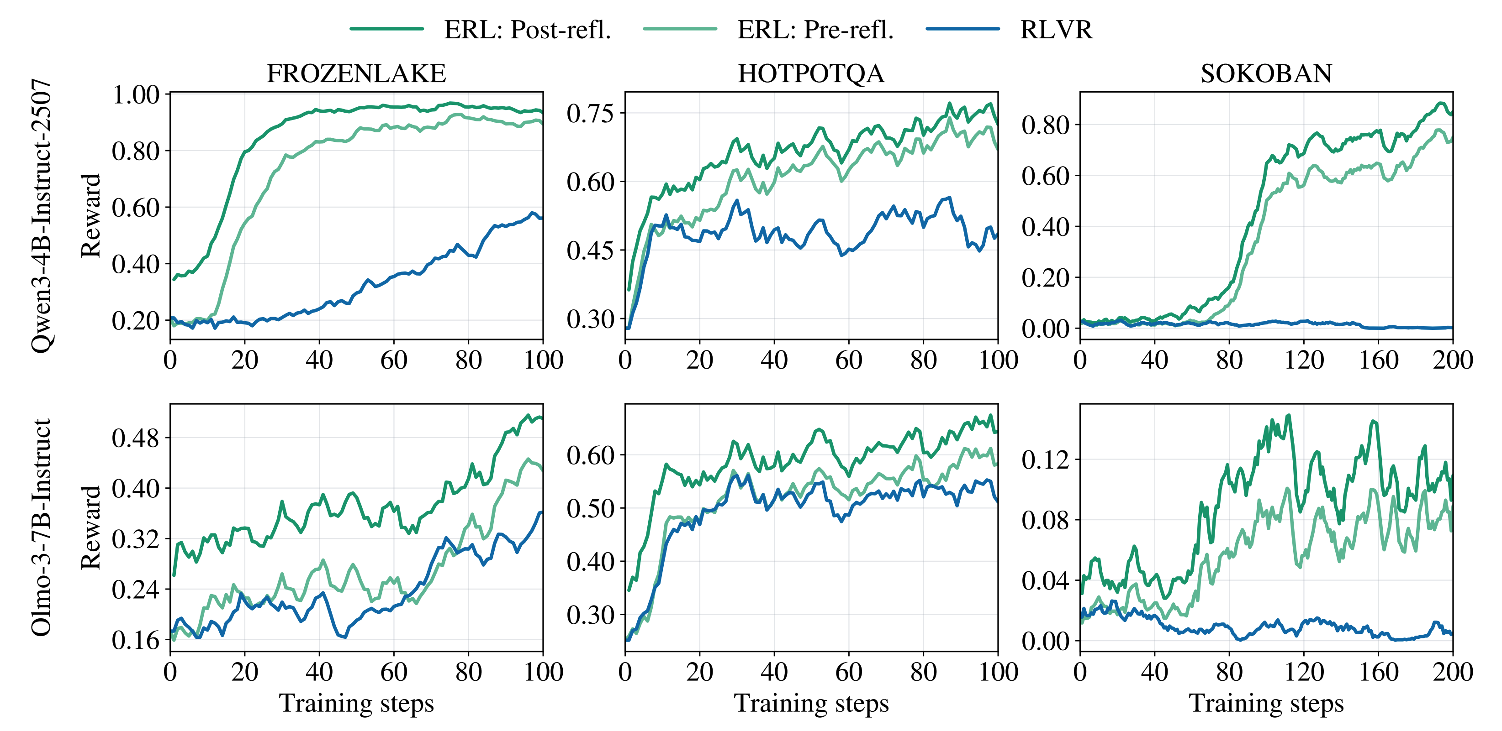
Mechanistic Role of Reflection

Slide 33
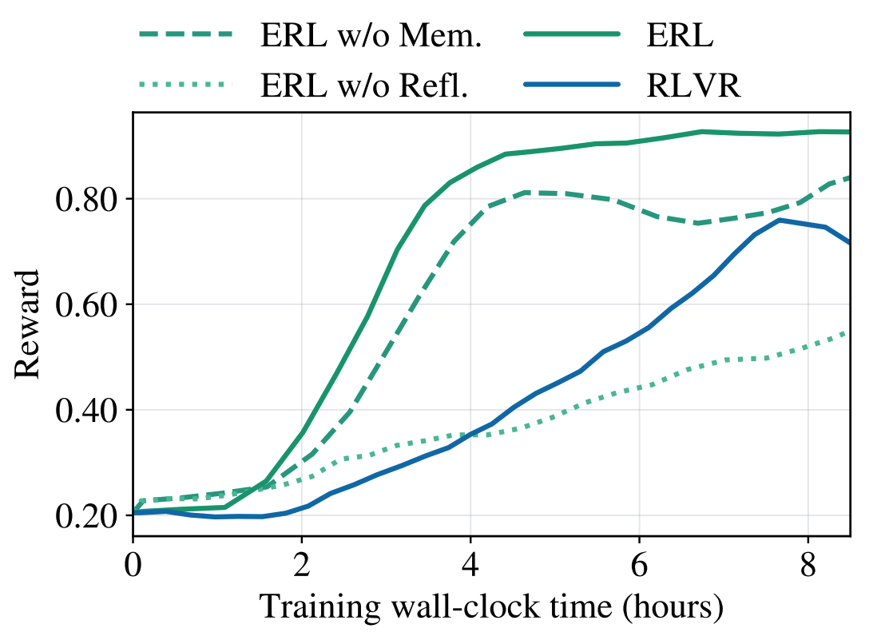
Ablation: Memory and Reflection
No memory: disables cross-episode memory storage
No Reflection: replaces reflections with raw first-attempt context and a generic retry instruction.

Slide 34
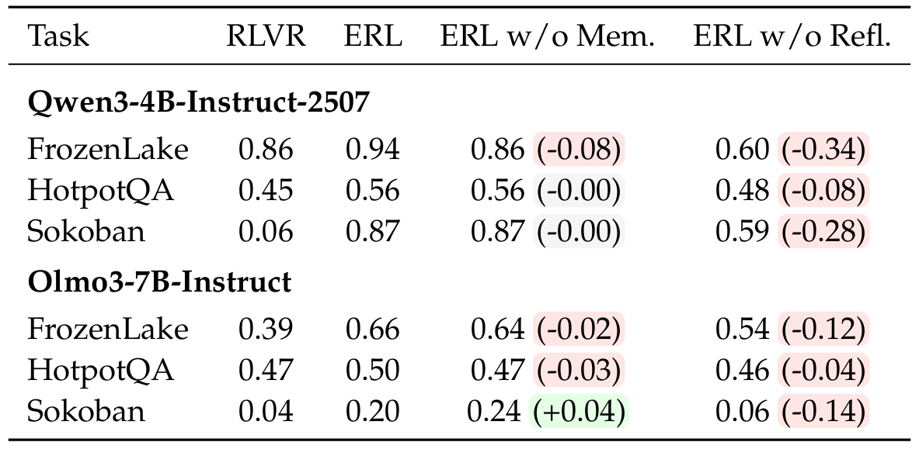
Ablation: Memory and Reflection
Full ERL achieves the highest performance
Removing memory slows convergence
Removing reflection substantially reduces both learning speed and final reward.

Slide 35
Summary
ERL enables LLM to learn and develop from their own “experience”
ERL performs better (i.e. not just more efficient) than standard RL
Especially when
Model is expected to learn some new (but persistent) knowledge
The model is not getting partial credit for mistakes

Slide 36
The next generation of AI systems must move beyond static human-curated data and learn continuously from real-world experience.

